Slide 1
BDD and Page Objects
Jukka Kinnunen, Anssi Soinu

Slide 2
Agenda
1.
BDD
2.
Page Objects
3.
Examples

Slide 3
BDD

Slide 4
Page Objects
Design Pattern
Software Testing Automation
User Interface Testing
Object which present one component in AUT

Slide 5
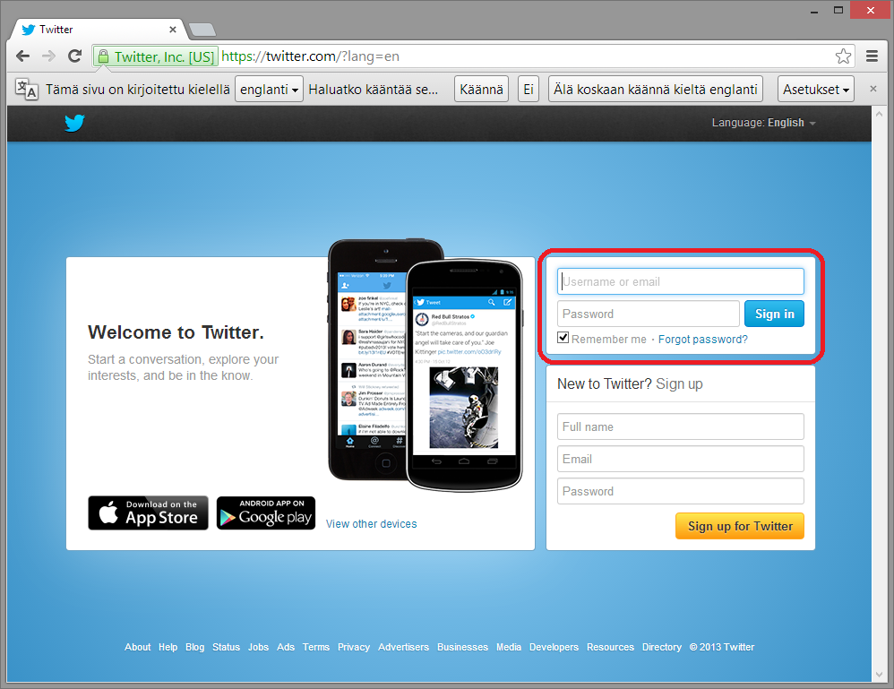
Page Objects

Slide 6
Page Objects

Slide 7
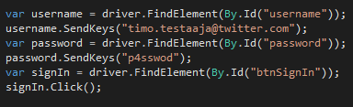
Page Objects

Slide 8

Page Objects

Slide 9
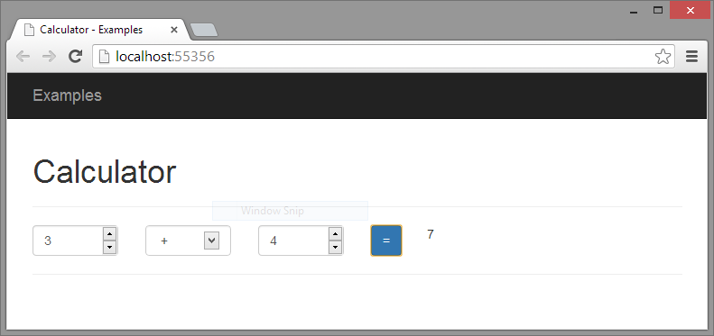
Example, The Calculator

Slide 10
Thank you!

